Slide 1
Academy, Fountain Park, Lewis Place Place, Vandeventer
Monthly Crime Report: April 2020
Washington University Medical Center

Slide 2
Academy: Summary Notes
18 total crimes in April 2020
12% change compared to April 2019 (16 total crimes)
10 crime(s) against persons in April 2020
100% change compared to April 2019 (5 crimes against persons)
48 total crimes in 2020
-28% change compared to this time in 2019 (67 total crimes)
20 crime(s) against persons in 2020
-26% change compared to this time in 2019 (27 crimes against persons)

Slide 3
Academy: Year to Year Comparison
Part 1 Crimes | Jan | Feb | Mar | Apr | May | Jun | Jul | Aug | Sep | Oct | Nov | Dec | Total
Aggravated Assault | 8 | 7 | 4 | 3 | 2 | 4 | 3 | 5 | 8 | 2 | 0 | 6 | 52
Arson | 0 | 1 | 0 | 0 | 0 | 0 | 1 | 0 | 0 | 4 | 0 | 1 | 7
Burgalry | 5 | 3 | 1 | 2 | 1 | 1 | 3 | 4 | 1 | 3 | 0 | 4 | 28
Homicide | 0 | 0 | 0 | 0 | 0 | 0 | 0 | 1 | 0 | 1 | 0 | 0 | 2
Larceny | 7 | 4 | 5 | 8 | 7 | 8 | 9 | 10 | 11 | 11 | 9 | 6 | 95
Motor Vehicle Theft | 2 | 1 | 0 | 1 | 1 | 4 | 4 | 2 | 1 | 3 | 2 | 3 | 24
Robbery | 0 | 1 | 2 | 2 | 2 | 0 | 0 | 5 | 2 | 1 | 1 | 0 | 16
Total | 22 | 17 | 12 | 16 | 13 | 17 | 20 | 27 | 23 | 25 | 12 | 20 | 224
Part 1 Crimes | Jan | Feb | Mar | Apr | Total
Aggravated Assault | 2 | 2 | 1 | 8 | 13
Arson | 0 | 0 | 0 | 1 | 1
Burgalry | 2 | 3 | 0 | 3 | 8
Homicide | 0 | 0 | 0 | 0 | 0
Larceny | 2 | 2 | 5 | 2 | 11
Motor Vehicle Theft | 2 | 1 | 3 | 2 | 8
Robbery | 1 | 0 | 4 | 2 | 7
Total | 9 | 8 | 13 | 18 | 48

Slide 4
Academy: Summary Tables
Day of the Week | Number of Crimes
Sun | 2
Mon | 2
Tue | 3
Wed | 3
Thu | 6
Fri | 1
Sat | 1
Total | 18
Part 1 Crimes | Number of Crimes
Aggravated Assault | 8
Arson | 1
Burgalry | 3
Larceny | 2
Motor Vehicle Theft | 2
Robbery | 2
Total | 18
Crimes Against Persons | Number of Crimes
FALSE | 8
TRUE | 10
Total | 18
Time of Day | Number of Crimes
Day | 15
Night | 3
Total | 18

Slide 5
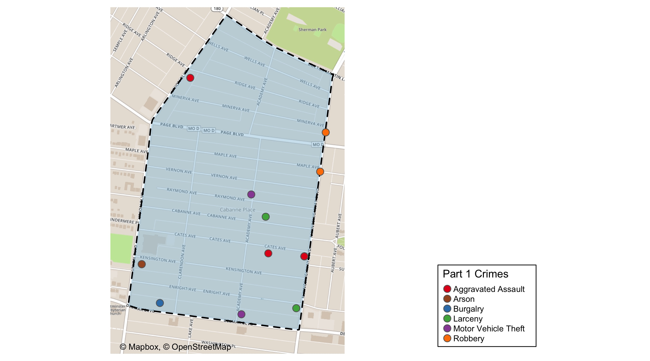
Academy: Total Crime Map

Slide 6
Fountain Park: Summary Notes
8 total crimes in April 2020
-33% change compared to April 2019 (12 total crimes)
3 crime(s) against persons in April 2020
-40% change compared to April 2019 (5 crimes against persons)
34 total crimes in 2020
-45% change compared to this time in 2019 (62 total crimes)
11 crime(s) against persons in 2020
-56% change compared to this time in 2019 (25 crimes against persons)

Slide 7
Fountain Park: Year to Year Comparison
Part 1 Crimes | Jan | Feb | Mar | Apr | May | Jun | Jul | Aug | Sep | Oct | Nov | Dec | Total
Aggravated Assault | 5 | 3 | 11 | 3 | 0 | 3 | 8 | 3 | 7 | 5 | 3 | 0 | 51
Arson | 0 | 0 | 0 | 1 | 0 | 0 | 0 | 1 | 0 | 0 | 0 | 0 | 2
Burgalry | 3 | 2 | 1 | 0 | 2 | 0 | 2 | 2 | 2 | 0 | 3 | 1 | 18
Homicide | 0 | 1 | 1 | 0 | 0 | 0 | 1 | 0 | 0 | 1 | 0 | 0 | 4
Larceny | 4 | 5 | 6 | 5 | 2 | 5 | 6 | 7 | 10 | 3 | 3 | 1 | 57
Motor Vehicle Theft | 3 | 0 | 4 | 1 | 0 | 2 | 2 | 0 | 2 | 1 | 0 | 0 | 15
Robbery | 1 | 0 | 0 | 2 | 0 | 3 | 1 | 5 | 0 | 2 | 1 | 1 | 16
Total | 16 | 11 | 23 | 12 | 4 | 13 | 20 | 18 | 21 | 12 | 10 | 3 | 163
Part 1 Crimes | Jan | Feb | Mar | Apr | Total
Aggravated Assault | 2 | 3 | 2 | 3 | 10
Arson | 0 | 0 | 1 | 0 | 1
Burgalry | 0 | 0 | 3 | 1 | 4
Homicide | 1 | 0 | 0 | 0 | 1
Larceny | 3 | 4 | 3 | 4 | 14
Motor Vehicle Theft | 0 | 3 | 0 | 0 | 3
Robbery | 1 | 0 | 0 | 0 | 1
Total | 7 | 10 | 9 | 8 | 34

Slide 8
Fountain Park: Summary Tables
Day of the Week | Number of Crimes
Sun | 0
Mon | 1
Tue | 0
Wed | 0
Thu | 2
Fri | 2
Sat | 3
Total | 8
Part 1 Crimes | Number of Crimes
Aggravated Assault | 3
Burgalry | 1
Larceny | 4
Total | 8
Crimes Against Persons | Number of Crimes
FALSE | 5
TRUE | 3
Total | 8
Time of Day | Number of Crimes
Day | 7
Night | 1
Total | 8

Slide 9
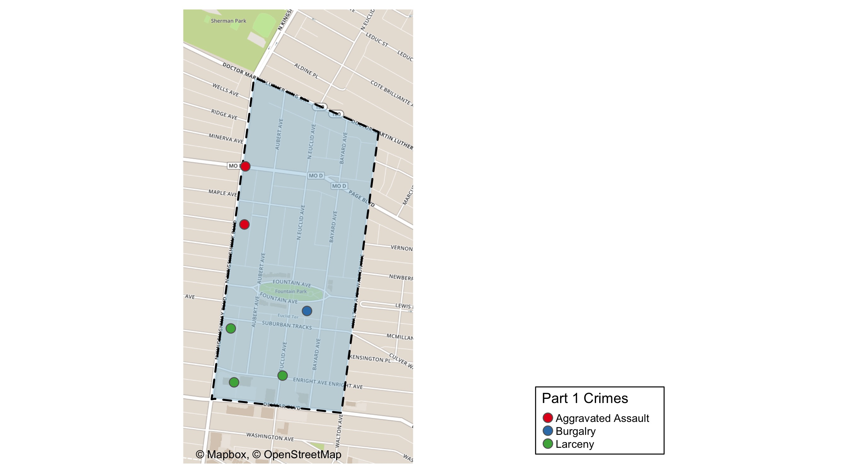
Fountain Park: Total Crime Map

Slide 10
Lewis Place: Summary Notes
4 total crimes in April 2020
-67% change compared to April 2019 (12 total crimes)
0 crime(s) against persons in April 2020
-100% change compared to April 2019 (3 crimes against persons)
32 total crimes in 2020
-3% change compared to this time in 2019 (33 total crimes)
14 crime(s) against persons in 2020
75% change compared to this time in 2019 (8 crimes against persons)

Slide 11
Lewis Place: Year to Year Comparison
Part 1 Crimes | Jan | Feb | Mar | Apr | May | Jun | Jul | Aug | Sep | Oct | Nov | Dec | Total
Aggravated Assault | 0 | 3 | 2 | 3 | 13 | 1 | 2 | 0 | 5 | 4 | 0 | 6 | 39
Arson | 0 | 1 | 0 | 0 | 1 | 0 | 0 | 0 | 0 | 0 | 0 | 0 | 2
Burgalry | 0 | 1 | 0 | 1 | 0 | 1 | 2 | 4 | 0 | 2 | 4 | 1 | 16
Homicide | 0 | 0 | 1 | 1 | 2 | 0 | 3 | 0 | 0 | 0 | 0 | 0 | 7
Larceny | 5 | 2 | 3 | 6 | 3 | 5 | 4 | 2 | 2 | 5 | 0 | 4 | 41
Motor Vehicle Theft | 0 | 1 | 2 | 1 | 1 | 1 | 0 | 1 | 5 | 1 | 1 | 3 | 17
Robbery | 0 | 0 | 0 | 0 | 1 | 0 | 1 | 1 | 1 | 0 | 0 | 1 | 5
Total | 5 | 8 | 8 | 12 | 21 | 8 | 12 | 8 | 13 | 12 | 5 | 15 | 127
Part 1 Crimes | Jan | Feb | Mar | Apr | Total
Aggravated Assault | 0 | 4 | 6 | 0 | 10
Arson | 0 | 0 | 1 | 0 | 1
Burgalry | 0 | 1 | 1 | 0 | 2
Homicide | 1 | 0 | 0 | 0 | 1
Larceny | 3 | 1 | 2 | 1 | 7
Motor Vehicle Theft | 2 | 2 | 0 | 3 | 7
Robbery | 0 | 1 | 3 | 0 | 4
Total | 6 | 9 | 13 | 4 | 32

Slide 12
Lewis Place: Summary Tables
Day of the Week | Number of Crimes
Sun | 0
Mon | 0
Tue | 3
Wed | 0
Thu | 0
Fri | 1
Sat | 0
Total | 4
Part 1 Crimes | Number of Crimes
Larceny | 1
Motor Vehicle Theft | 3
Total | 4
Crimes Against Persons | Number of Crimes
FALSE | 4
Total | 4
Time of Day | Number of Crimes
Day | 4
Total | 4

Slide 13
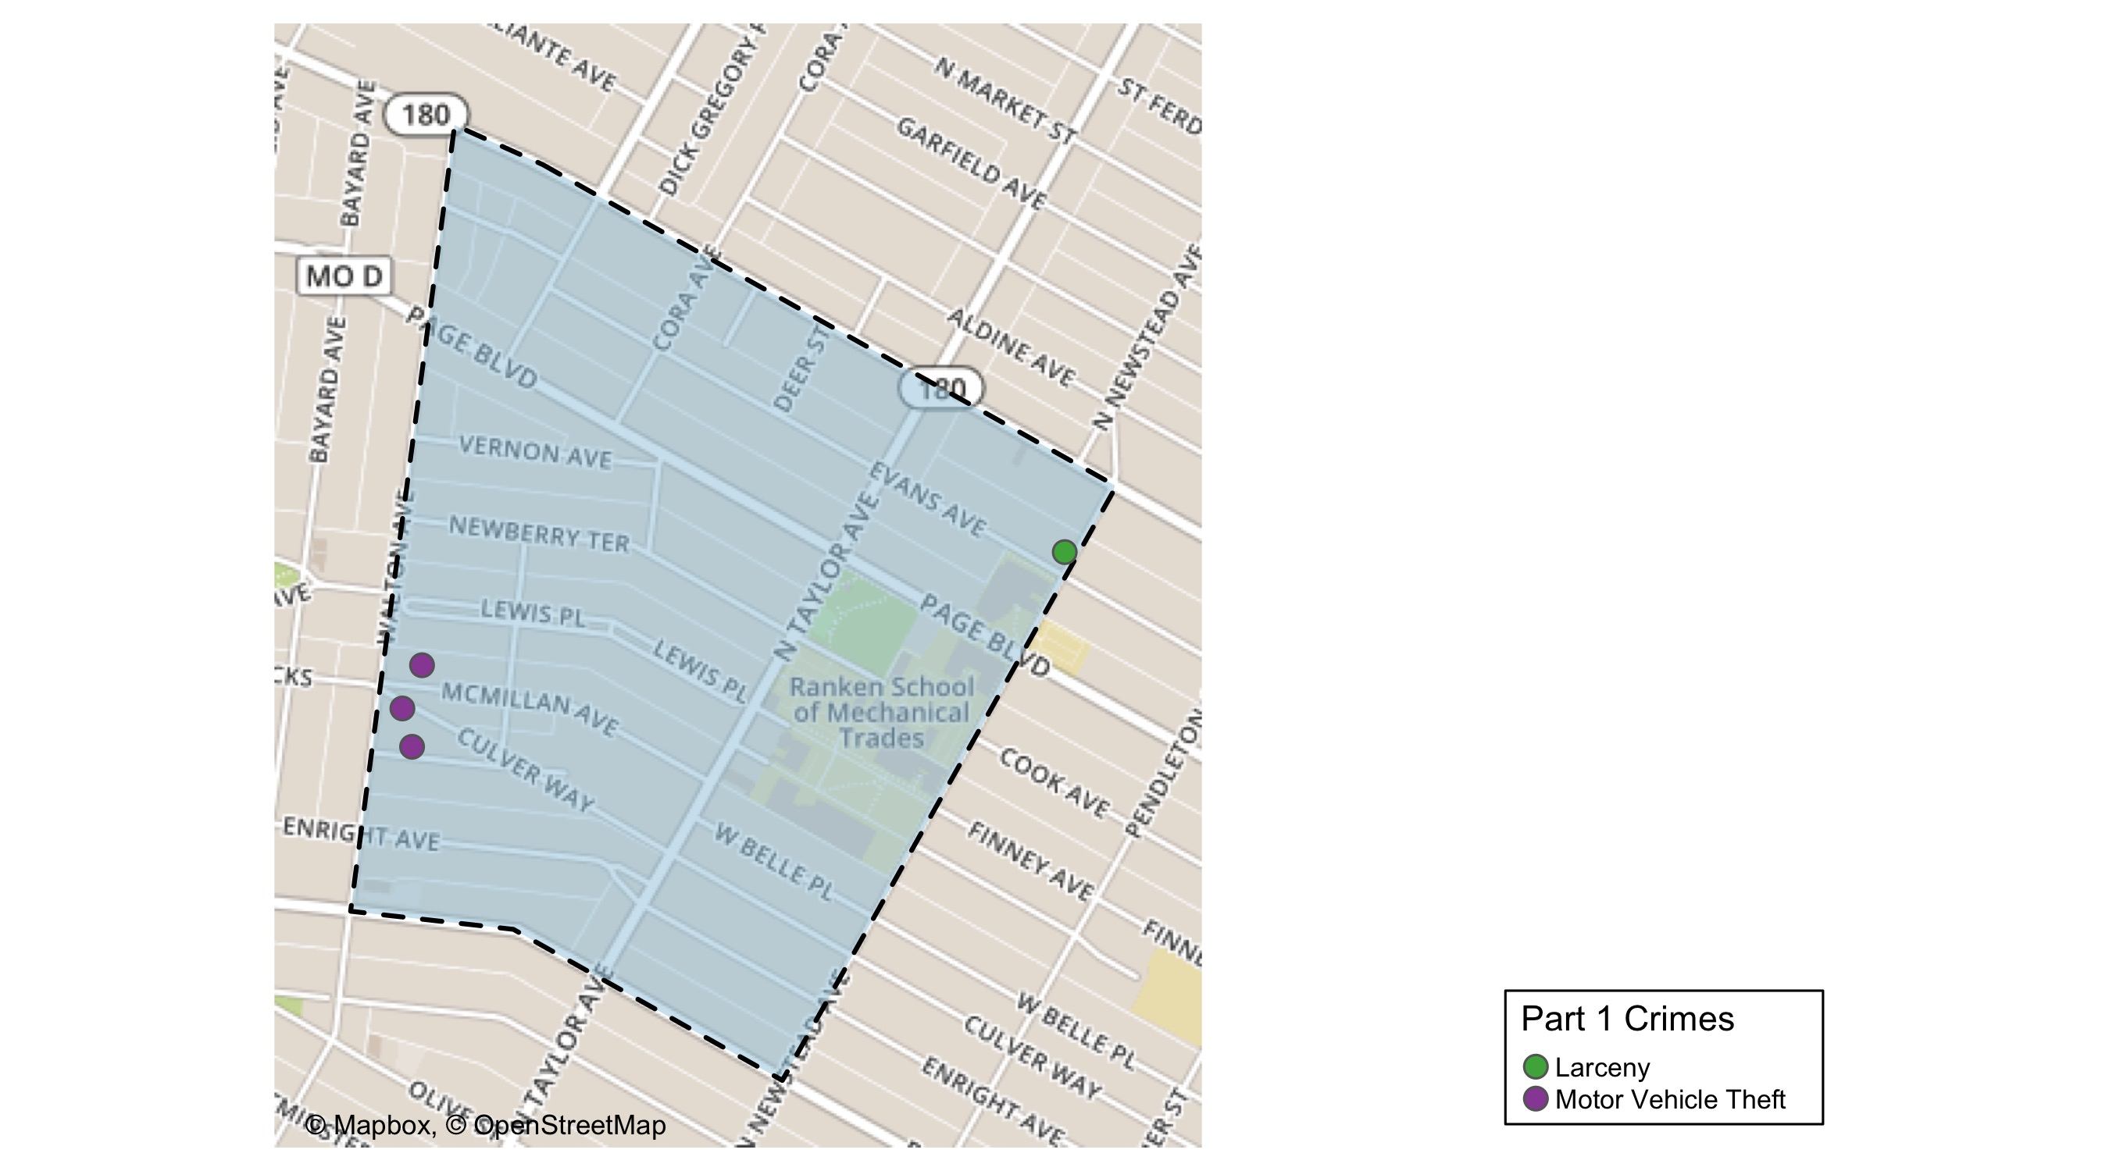
Lewis Place: Total Crime Map

Slide 14
Vandeventer: Summary Notes
8 total crimes in April 2020
-20% change compared to April 2019 (10 total crimes)
1 crime(s) against persons in April 2020
-50% change compared to April 2019 (2 crimes against persons)
46 total crimes in 2020
10% change compared to this time in 2019 (42 total crimes)
13 crime(s) against persons in 2020
18% change compared to this time in 2019 (11 crimes against persons)

Slide 15
Vandeventer: Year to Year Comparison
Part 1 Crimes | Jan | Feb | Mar | Apr | May | Jun | Jul | Aug | Sep | Oct | Nov | Dec | Total
Aggravated Assault | 0 | 2 | 6 | 2 | 4 | 0 | 1 | 3 | 1 | 3 | 0 | 2 | 24
Arson | 0 | 1 | 0 | 0 | 0 | 0 | 0 | 0 | 0 | 0 | 0 | 0 | 1
Burgalry | 1 | 2 | 5 | 3 | 5 | 4 | 3 | 1 | 2 | 3 | 5 | 2 | 36
Homicide | 0 | 0 | 1 | 0 | 0 | 0 | 0 | 0 | 0 | 0 | 0 | 0 | 1
Larceny | 5 | 2 | 3 | 5 | 4 | 5 | 14 | 13 | 17 | 6 | 9 | 7 | 90
Motor Vehicle Theft | 0 | 2 | 1 | 0 | 0 | 2 | 1 | 3 | 1 | 1 | 1 | 0 | 12
Robbery | 0 | 0 | 1 | 0 | 1 | 4 | 0 | 0 | 1 | 2 | 1 | 1 | 11
Total | 6 | 9 | 17 | 10 | 14 | 15 | 19 | 20 | 22 | 15 | 16 | 12 | 175
Part 1 Crimes | Jan | Feb | Mar | Apr | Total
Aggravated Assault | 0 | 4 | 5 | 0 | 9
Arson | 0 | 0 | 0 | 0 | 0
Burgalry | 2 | 2 | 0 | 1 | 5
Homicide | 0 | 0 | 0 | 0 | 0
Larceny | 9 | 1 | 7 | 5 | 22
Motor Vehicle Theft | 2 | 1 | 2 | 1 | 6
Robbery | 1 | 1 | 1 | 1 | 4
Total | 14 | 9 | 15 | 8 | 46

Slide 16
Vandeventer: Summary Tables
Day of the Week | Number of Crimes
Sun | 1
Mon | 1
Tue | 2
Wed | 1
Thu | 2
Fri | 1
Sat | 0
Total | 8
Part 1 Crimes | Number of Crimes
Burgalry | 1
Larceny | 5
Motor Vehicle Theft | 1
Robbery | 1
Total | 8
Crimes Against Persons | Number of Crimes
FALSE | 7
TRUE | 1
Total | 8
Time of Day | Number of Crimes
Day | 6
Night | 2
Total | 8

Slide 17
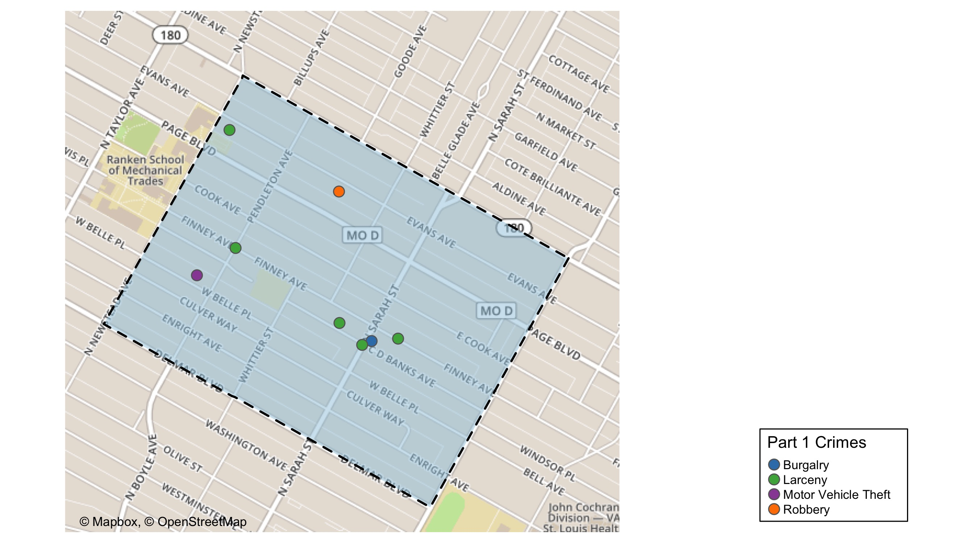
Vandeventer: Total Crime Map

Slide 18
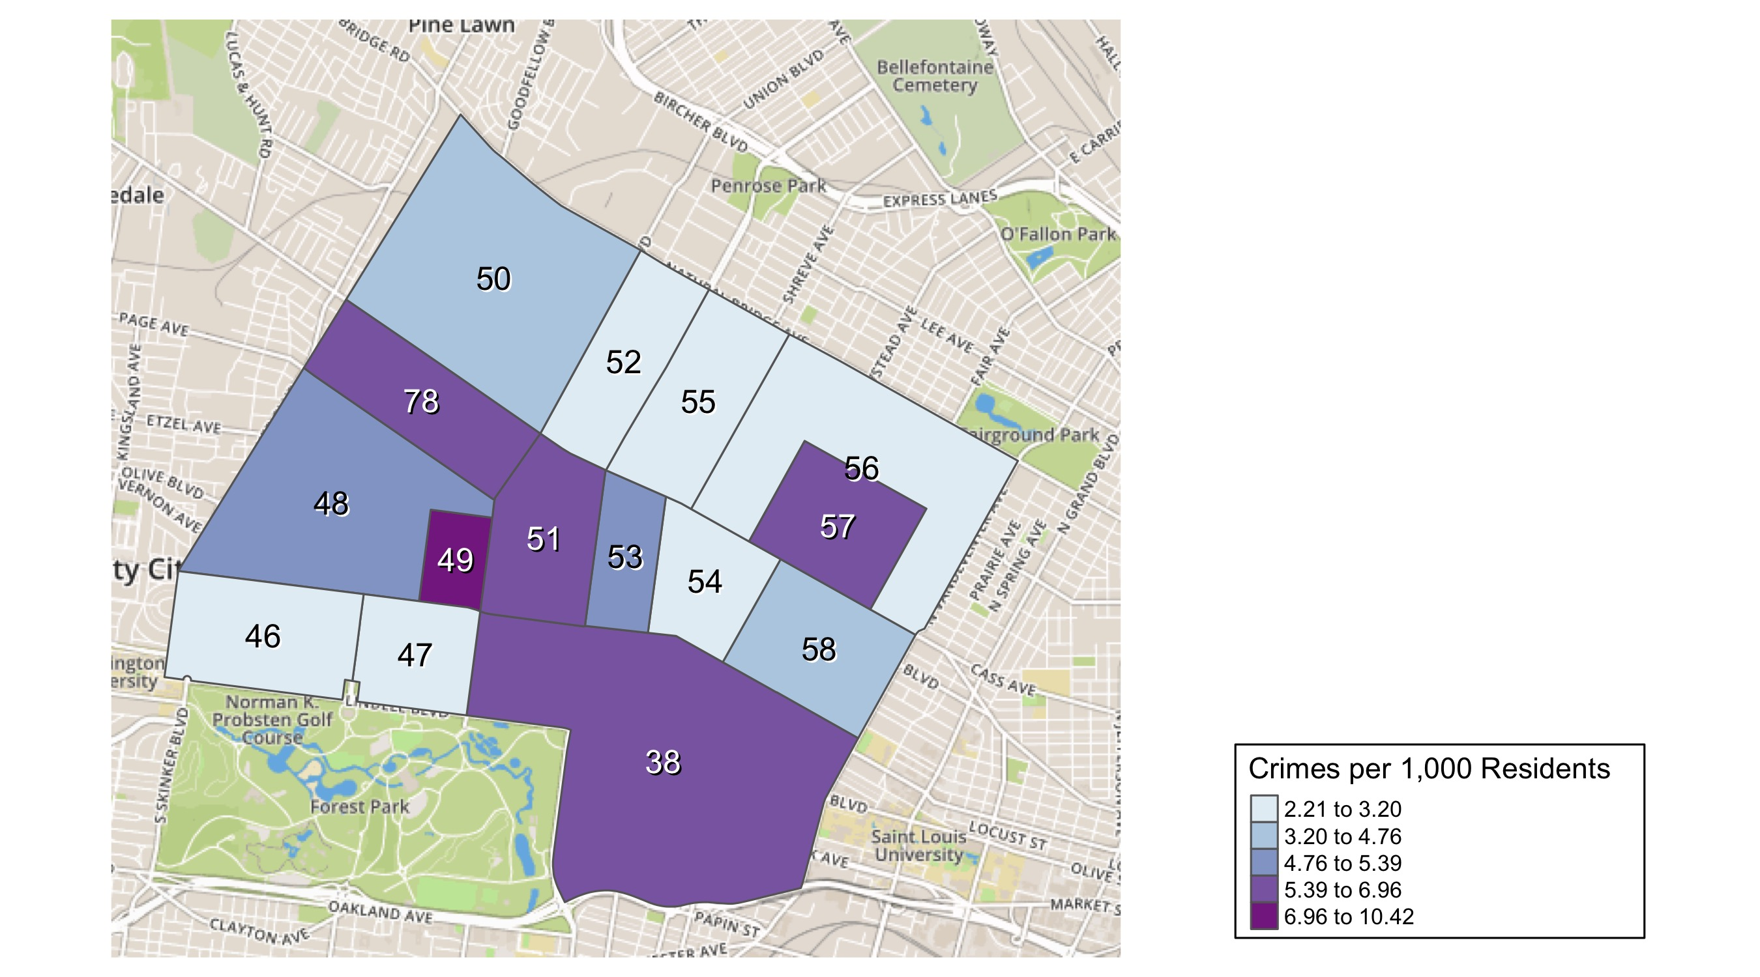
District 5: Crime Rates Map

Slide 19
District 5: Density Map Explanation
There are 15 neighborhoods in District 5
The minimum number of crimes in one neighborhood was 4 (Lewis Place)
The maximum number of crimes in one neighborhood was 90 (Central West End)
The mean number of crimes in one neighborhood was 19
The minimum rate of crimes in one neighborhood was 2.21 (Skinker DeBaliviere)
The maximum rate of crimes in one neighborhood was 10.42 (Visitation Park)
The mean rate of crimes in one neighborhood was 4.79

Slide 20
Academy: Neighborhood Detail
Appendix 1

Slide 21
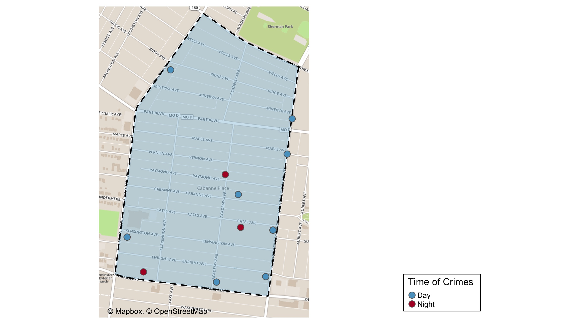
Academy: Time of Crimes Map

Slide 22
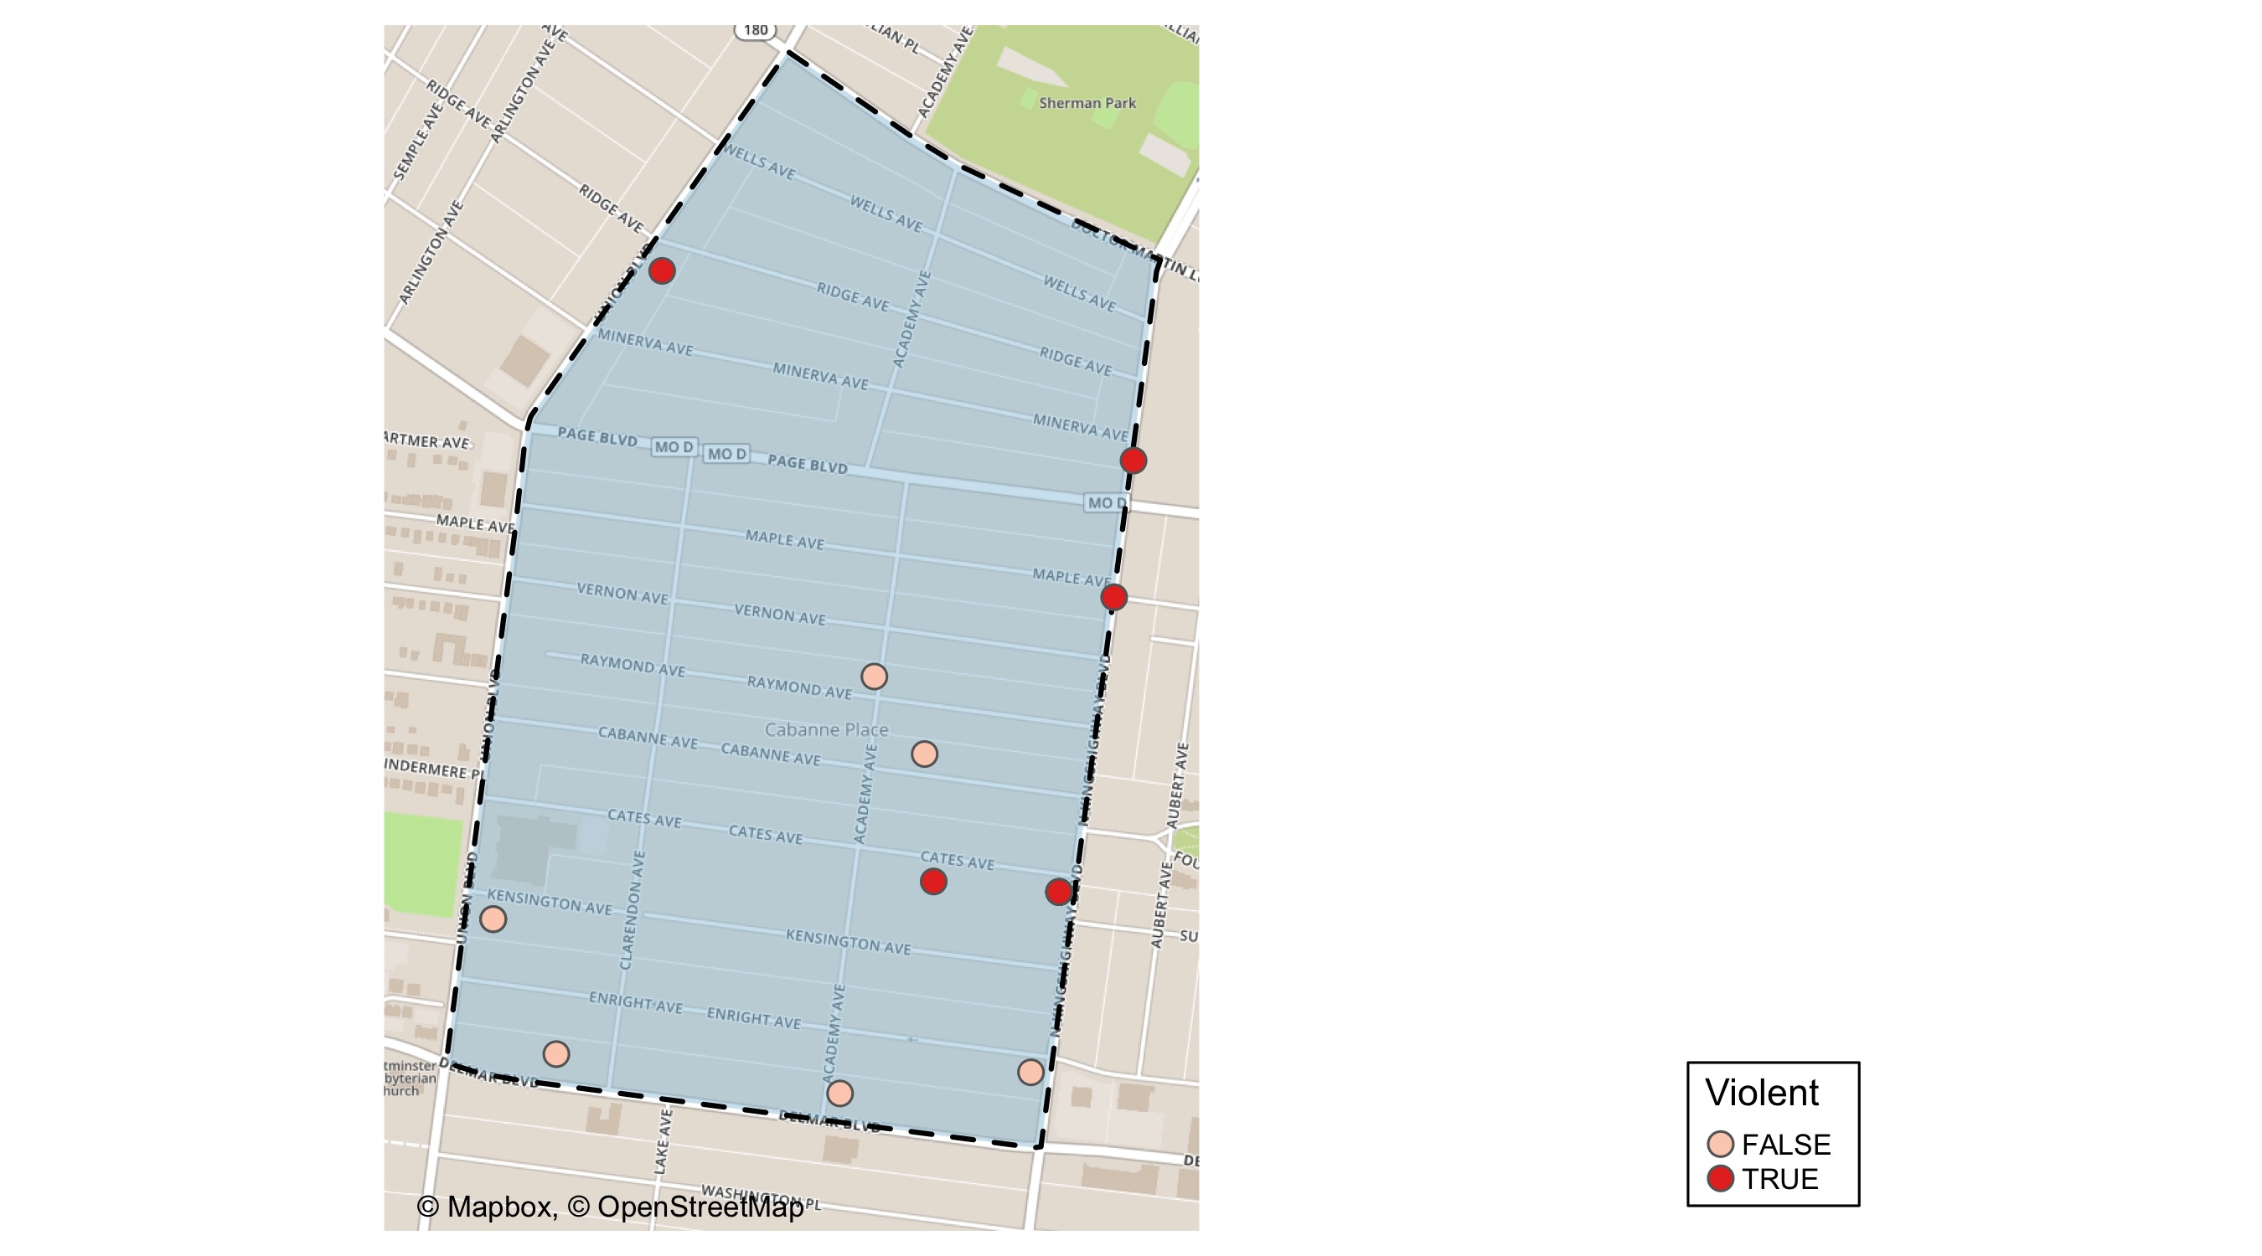
Academy: Violent Crime Map

Slide 23
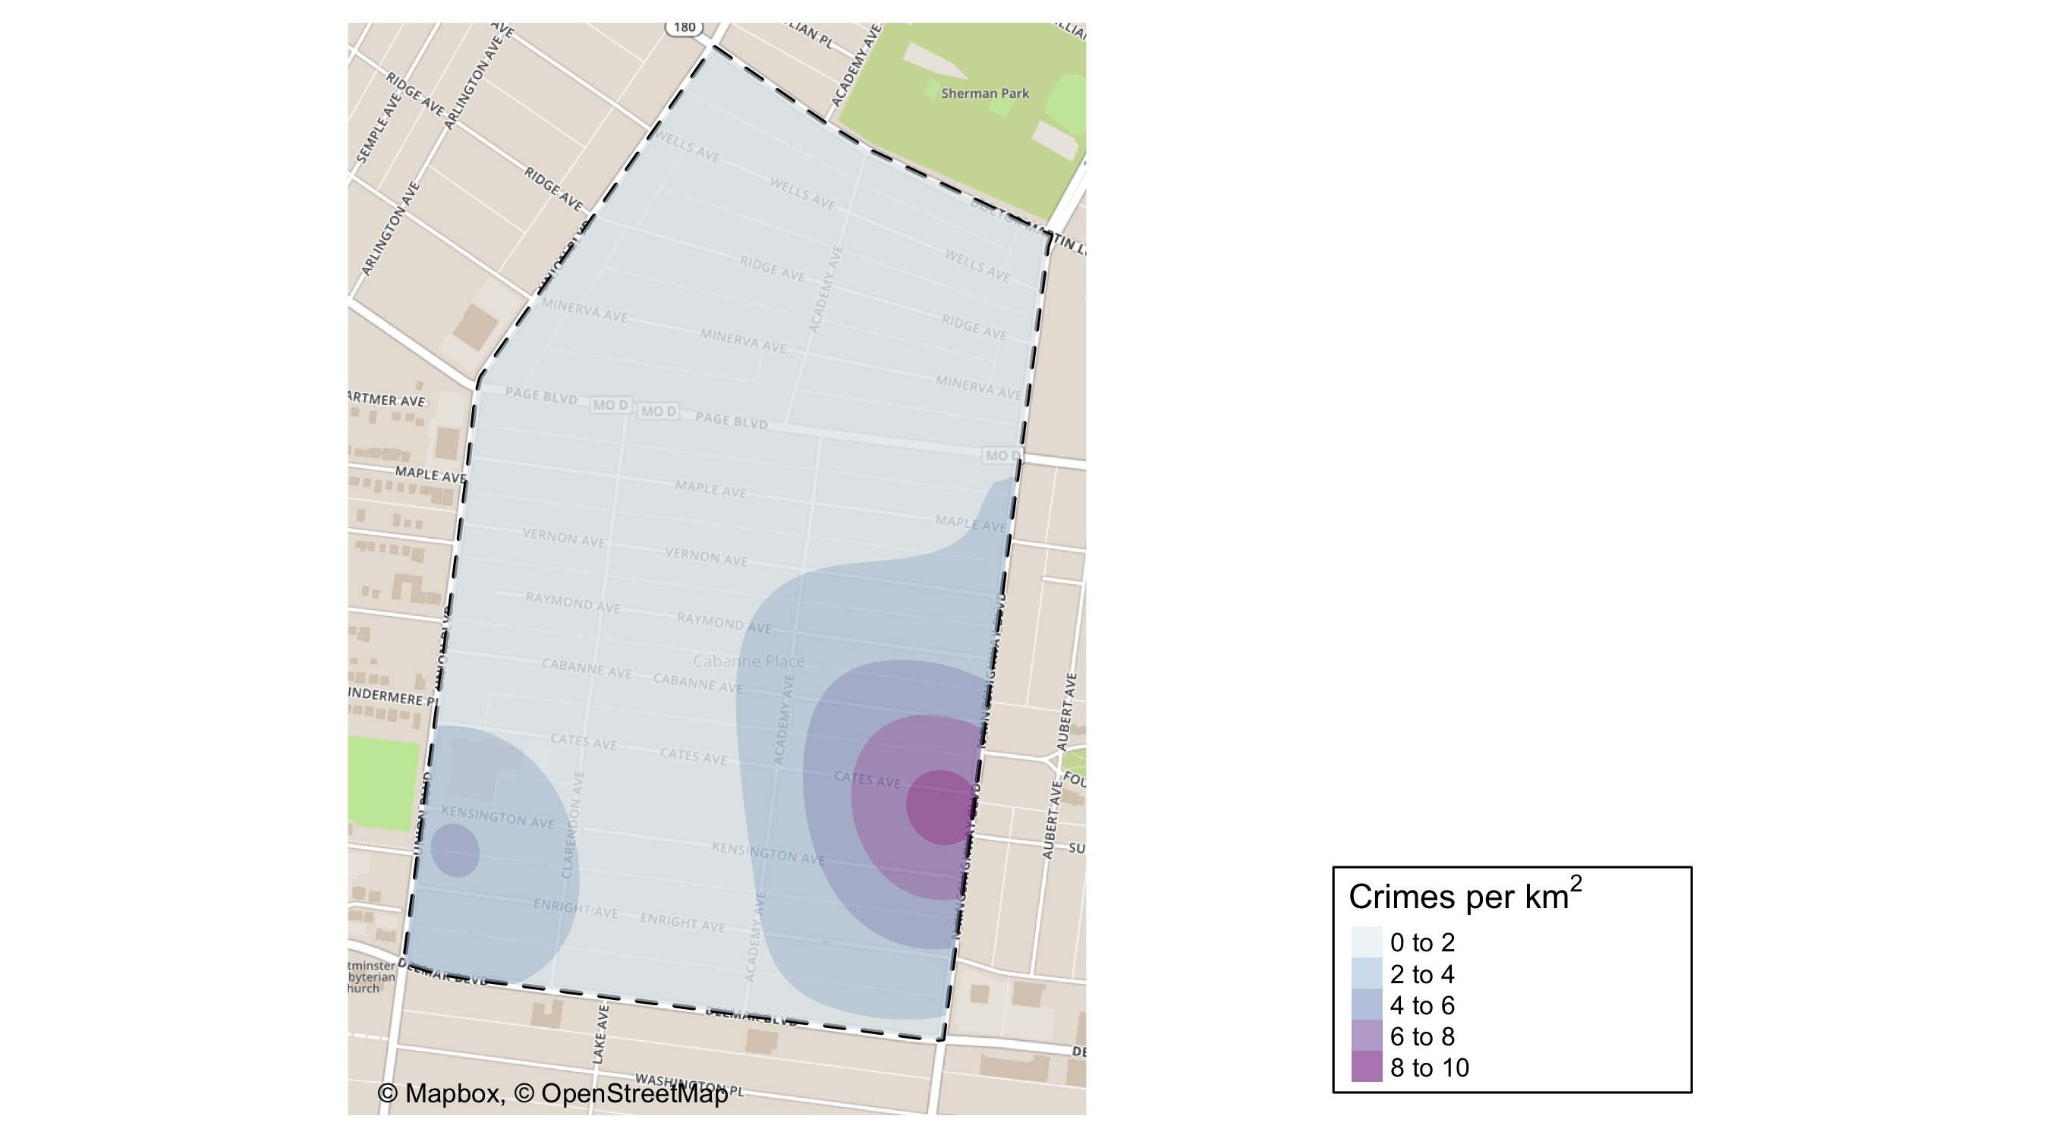
Academy: Crime Density Map

Slide 24
Academy: Larceny Breakdown
Day of the Week | Number of Crimes
Tue | 1
Wed | 1
Total | 2
Type of Larceny | Number of Crimes
All Other | 1
From Motor Vehicle | 1
Total | 2
Time of Day | Number of Crimes
Day | 2
Total | 2
Monetary | Number of Crimes
Under $500 | 2
Total | 2

Slide 25
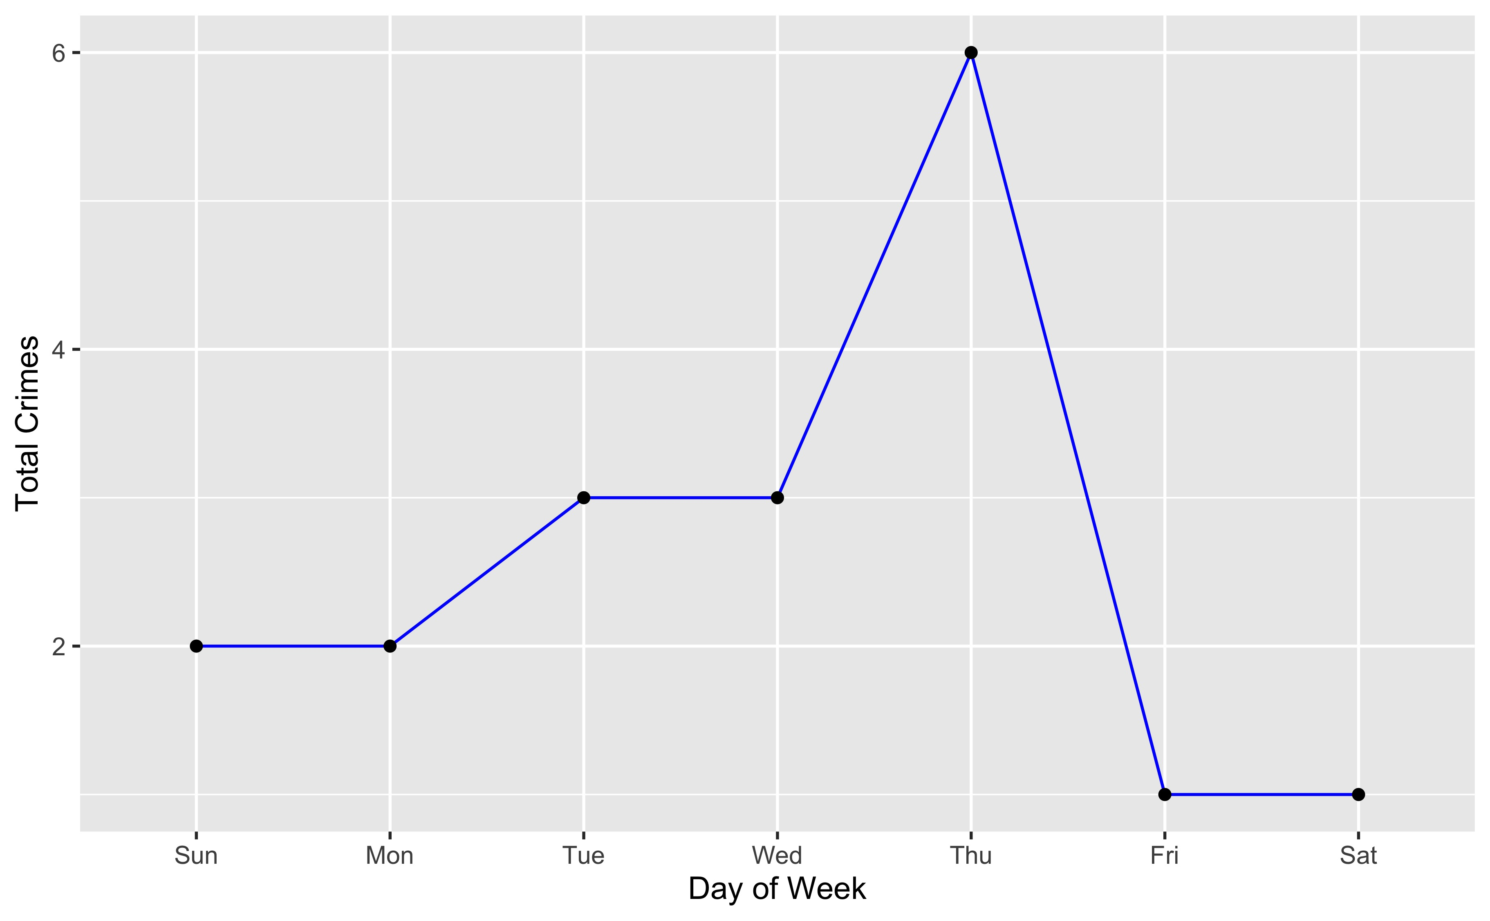
Academy: Total Crimes by Days of the Week

Slide 26
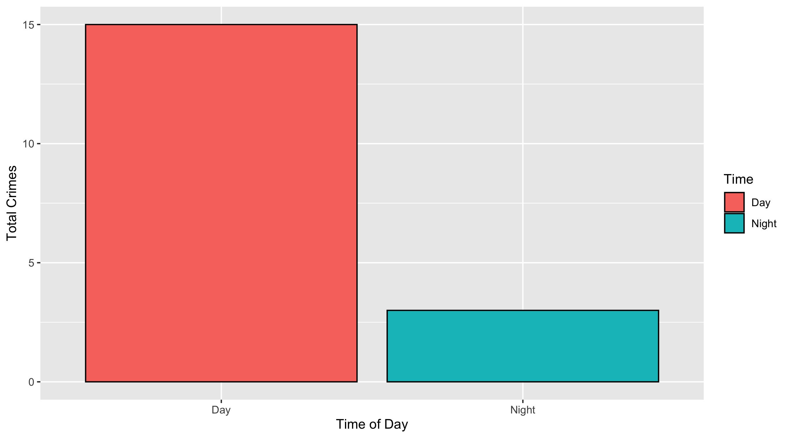
Academy: Crimes by Time of Day

Slide 27
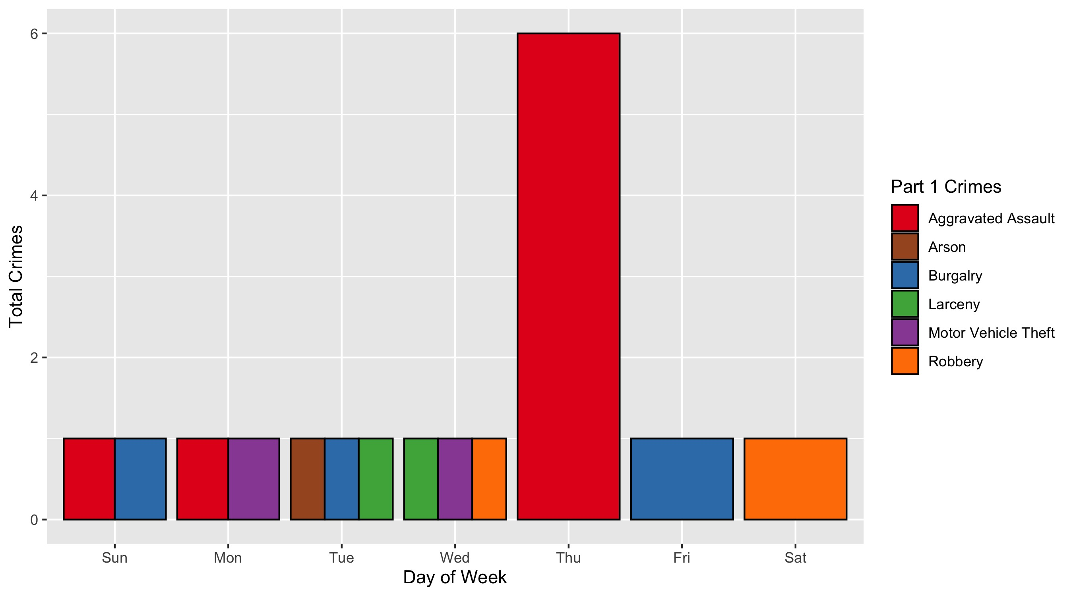
Academy: Crimes by Day and Category

Slide 28
Fountain Park: Neighborhood Detail
Appendix 2

Slide 29
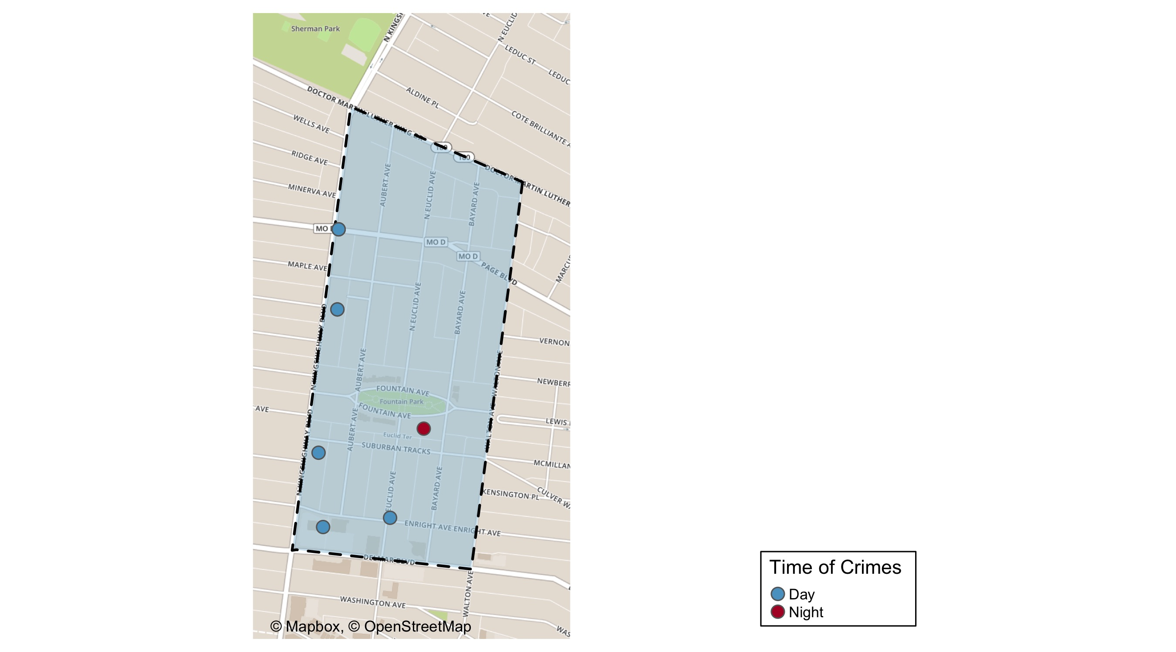
Fountain Park: Time of Crimes Map

Slide 30
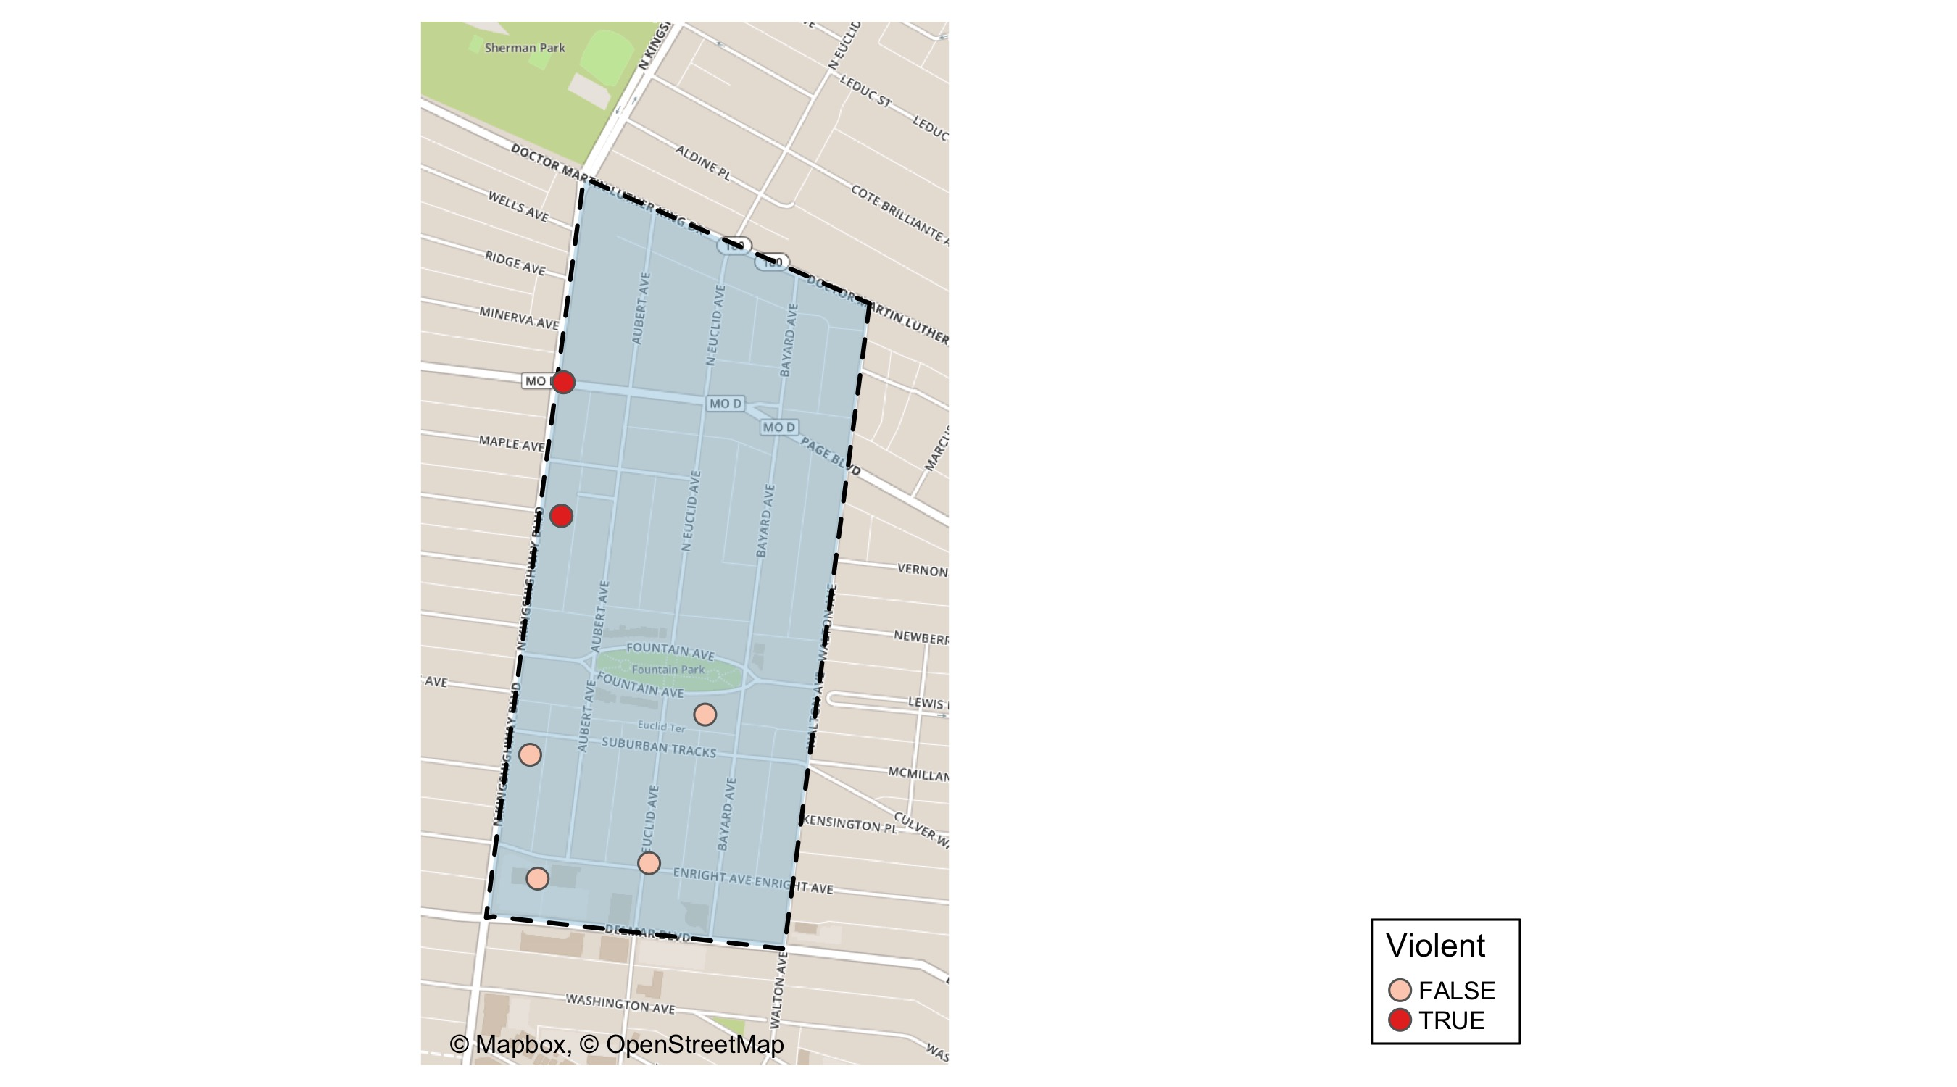
Fountain Park: Violent Crime Map

Slide 31
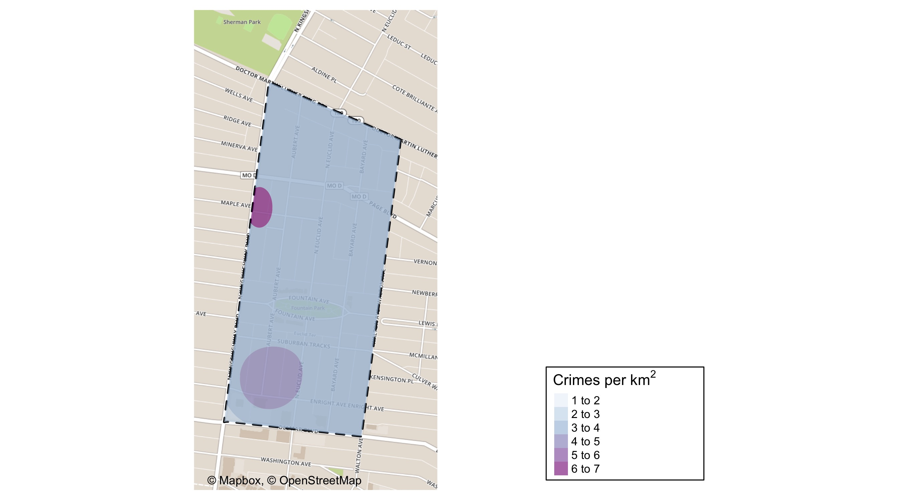
Fountain Park: Crime Density Map

Slide 32
Fountain Park: Larceny Breakdown
Day of the Week | Number of Crimes
Thu | 2
Fri | 1
Sat | 1
Total | 4
Type of Larceny | Number of Crimes
From Motor Vehicle | 1
Motor Vehicle Parts | 2
Shoplifting | 1
Total | 4
Time of Day | Number of Crimes
Day | 4
Total | 4
Monetary | Number of Crimes
Under $500 | 4
Total | 4

Slide 33
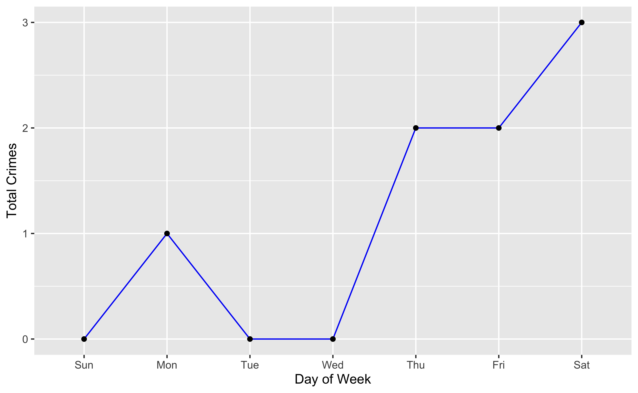
Fountain Park: Total Crimes by Days of the Week

Slide 34
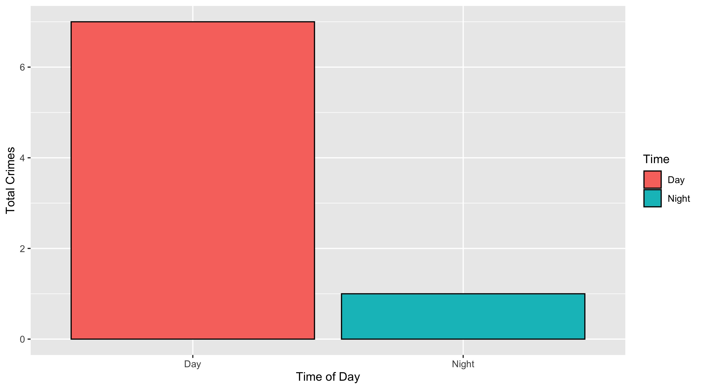
Fountain Park: Crimes by Time of Day

Slide 35
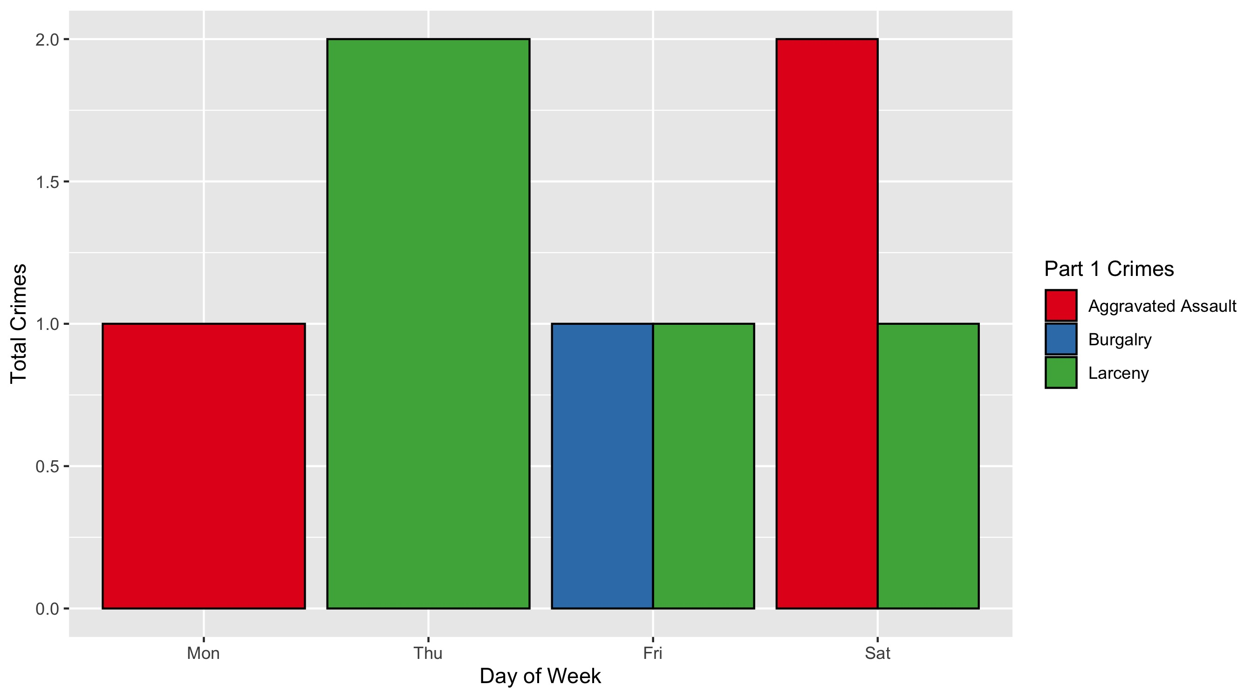
Fountain Park: Crimes by Day and Category

Slide 36
Lewis Place: Neighborhood Detail
Appendix 3

Slide 37
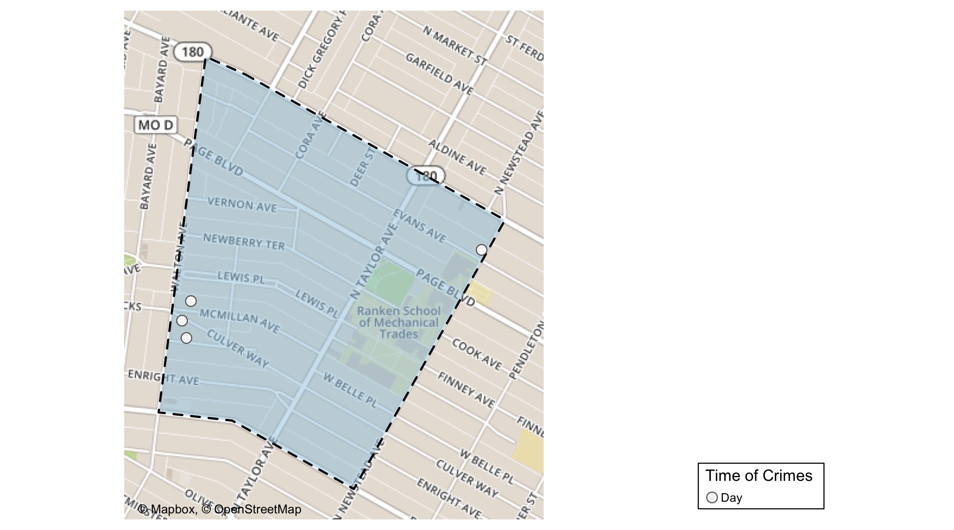
Lewis Place: Time of Crimes Map

Slide 38
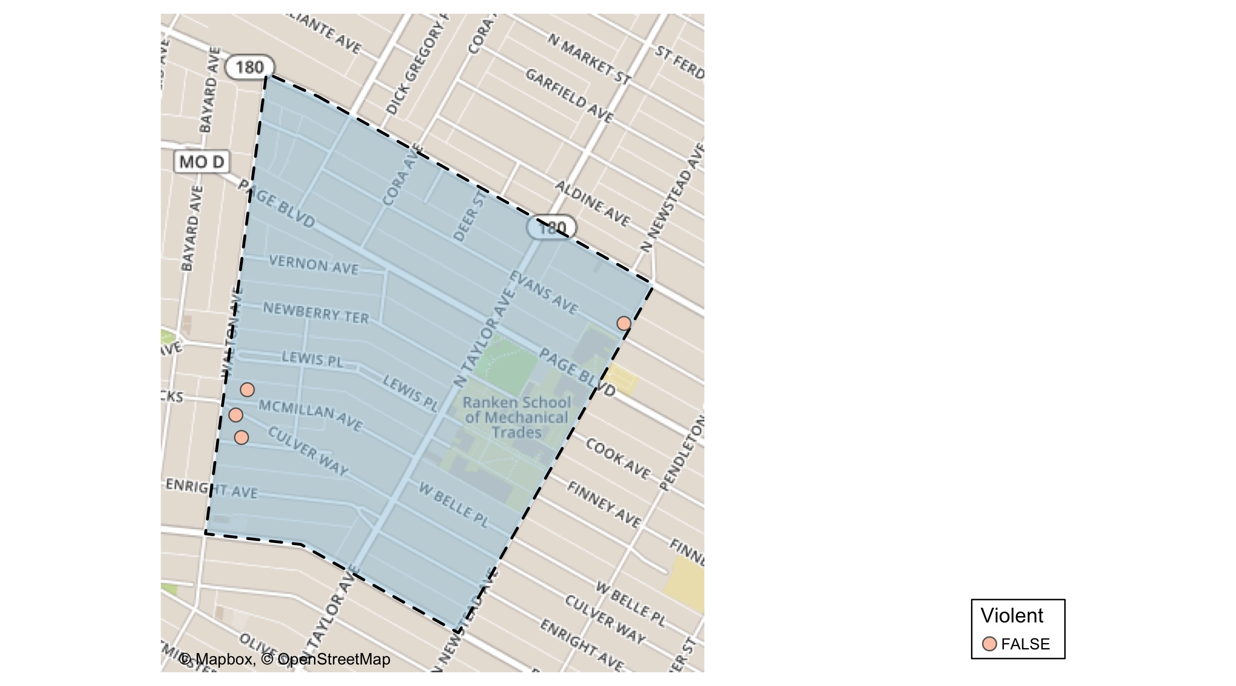
Lewis Place: Violent Crime Map

Slide 39
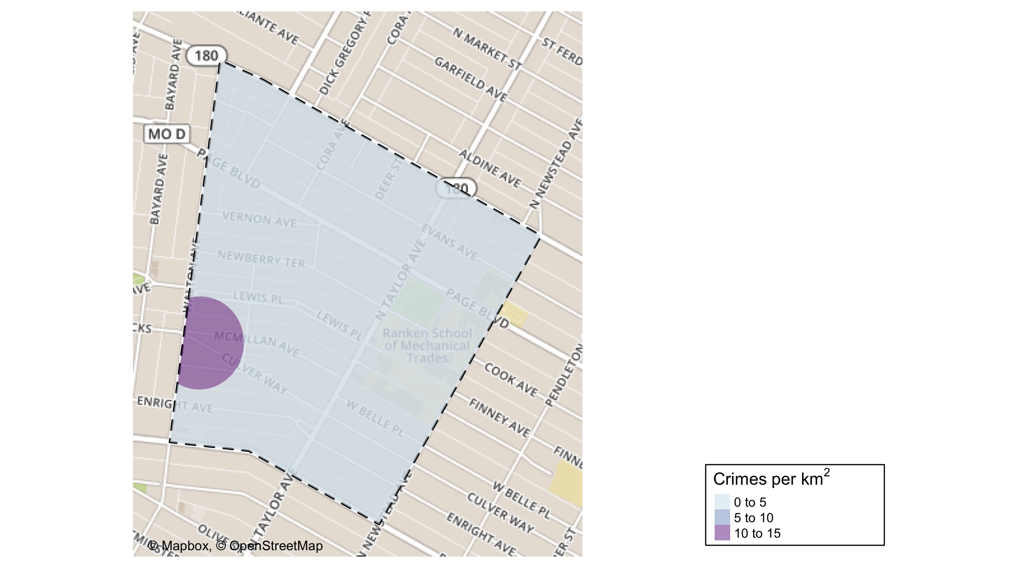
Lewis Place: Crime Density Map

Slide 40
Lewis Place: Larceny Breakdown
Day of the Week | Number of Crimes
Tue | 1
Total | 1
Type of Larceny | Number of Crimes
All Other | 1
Total | 1
Time of Day | Number of Crimes
Day | 1
Total | 1
Monetary | Number of Crimes
Under $500 | 1
Total | 1

Slide 41
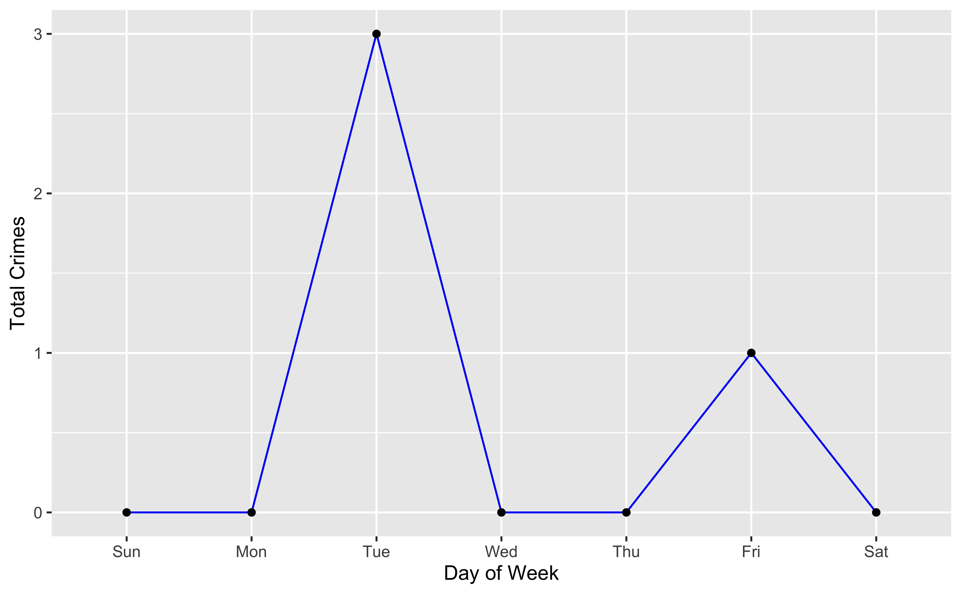
Lewis Place: Total Crimes by Days of the Week

Slide 42
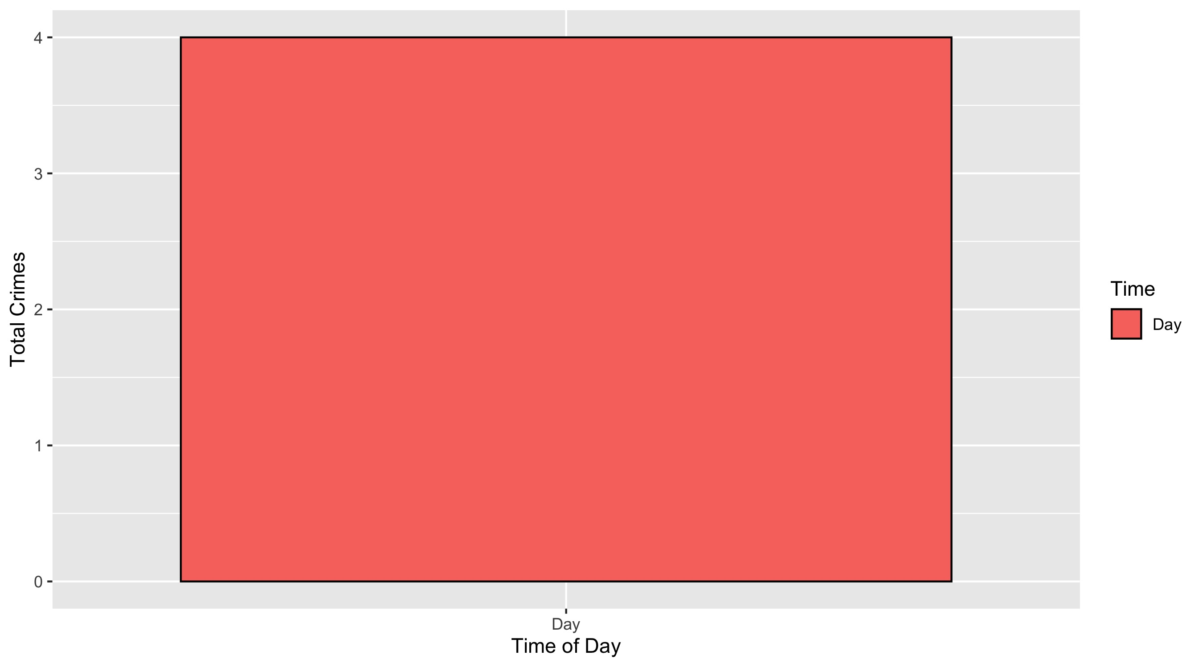
Lewis Place: Crimes by Time of Day

Slide 43
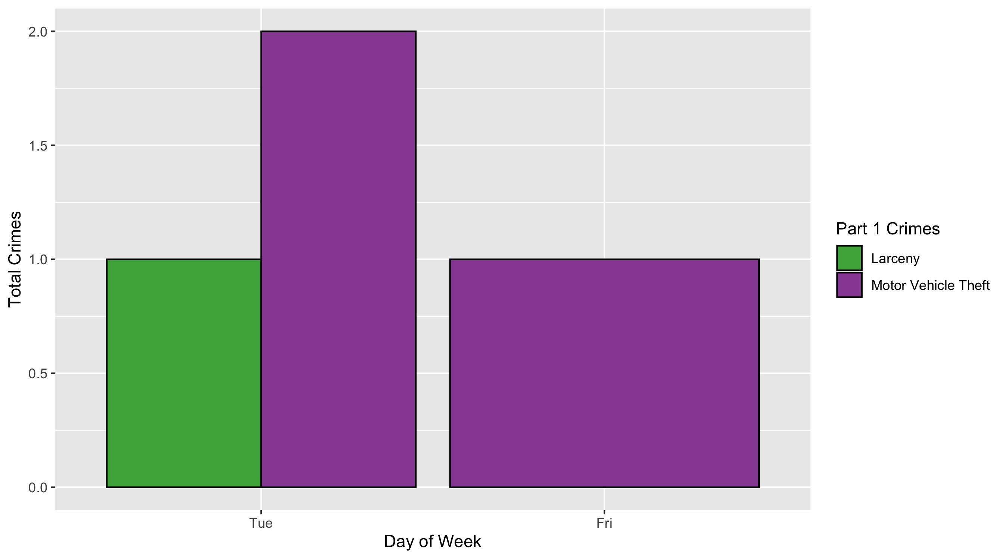
Lewis Place: Crimes by Day and Category

Slide 44
Vandevneter: Neighborhood Detail
Appendix 4

Slide 45
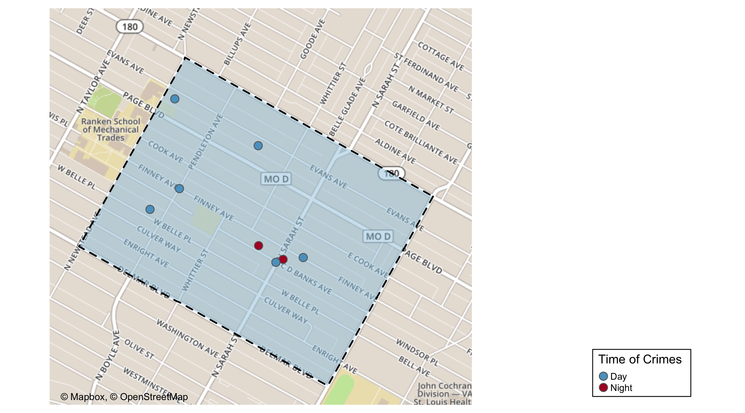
Vandeventer: Time of Crimes Map

Slide 46
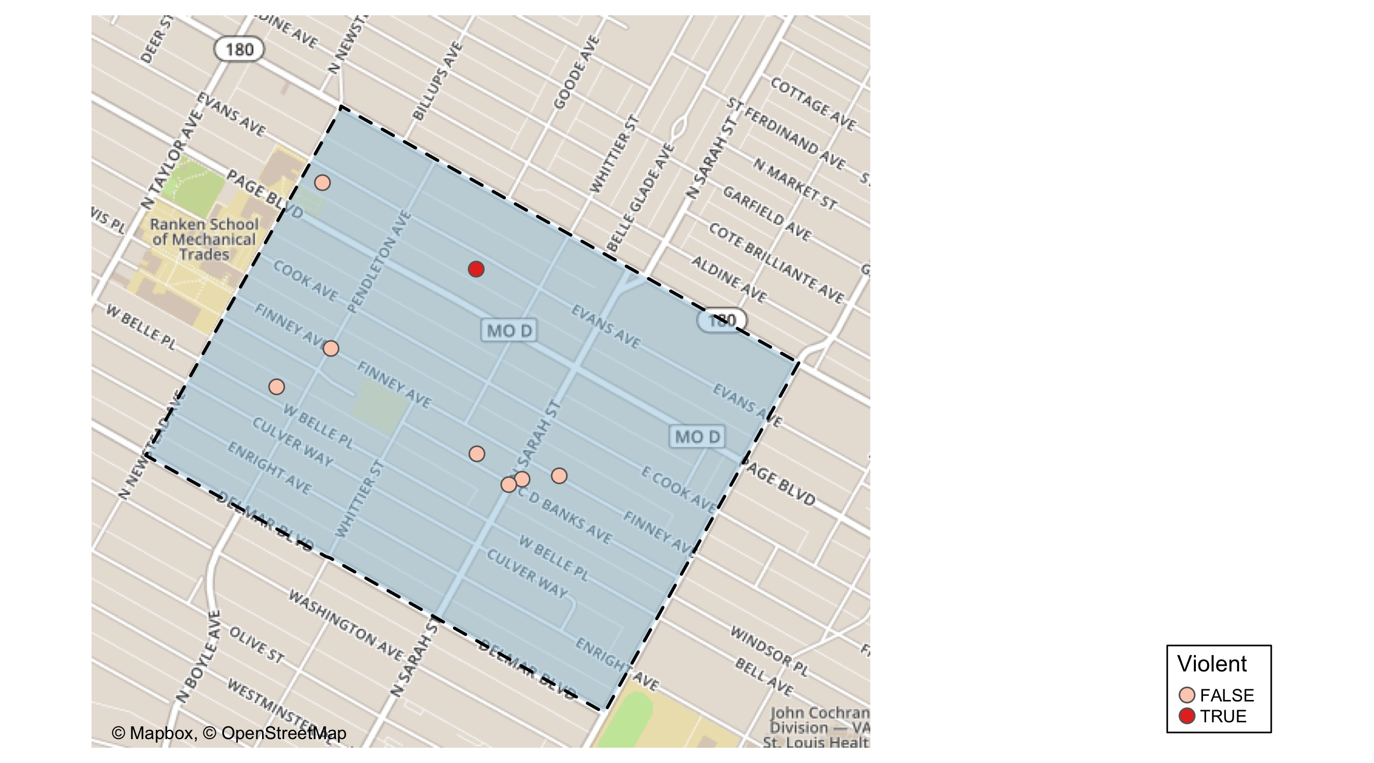
Vandeventer: Violent Crime Map

Slide 47
Vandeventer: Crime Density Map

Slide 48
Vandeventer: Larceny Breakdown
Day of the Week | Number of Crimes
Tue | 1
Wed | 1
Thu | 2
Fri | 1
Total | 5
Type of Larceny | Number of Crimes
All Other | 3
From Building | 1
Motor Vehicle Parts | 1
Total | 5
Time of Day | Number of Crimes
Day | 4
Night | 1
Total | 5
Monetary | Number of Crimes
$500 - $24,999 | 3
Under $500 | 2
Total | 5

Slide 49
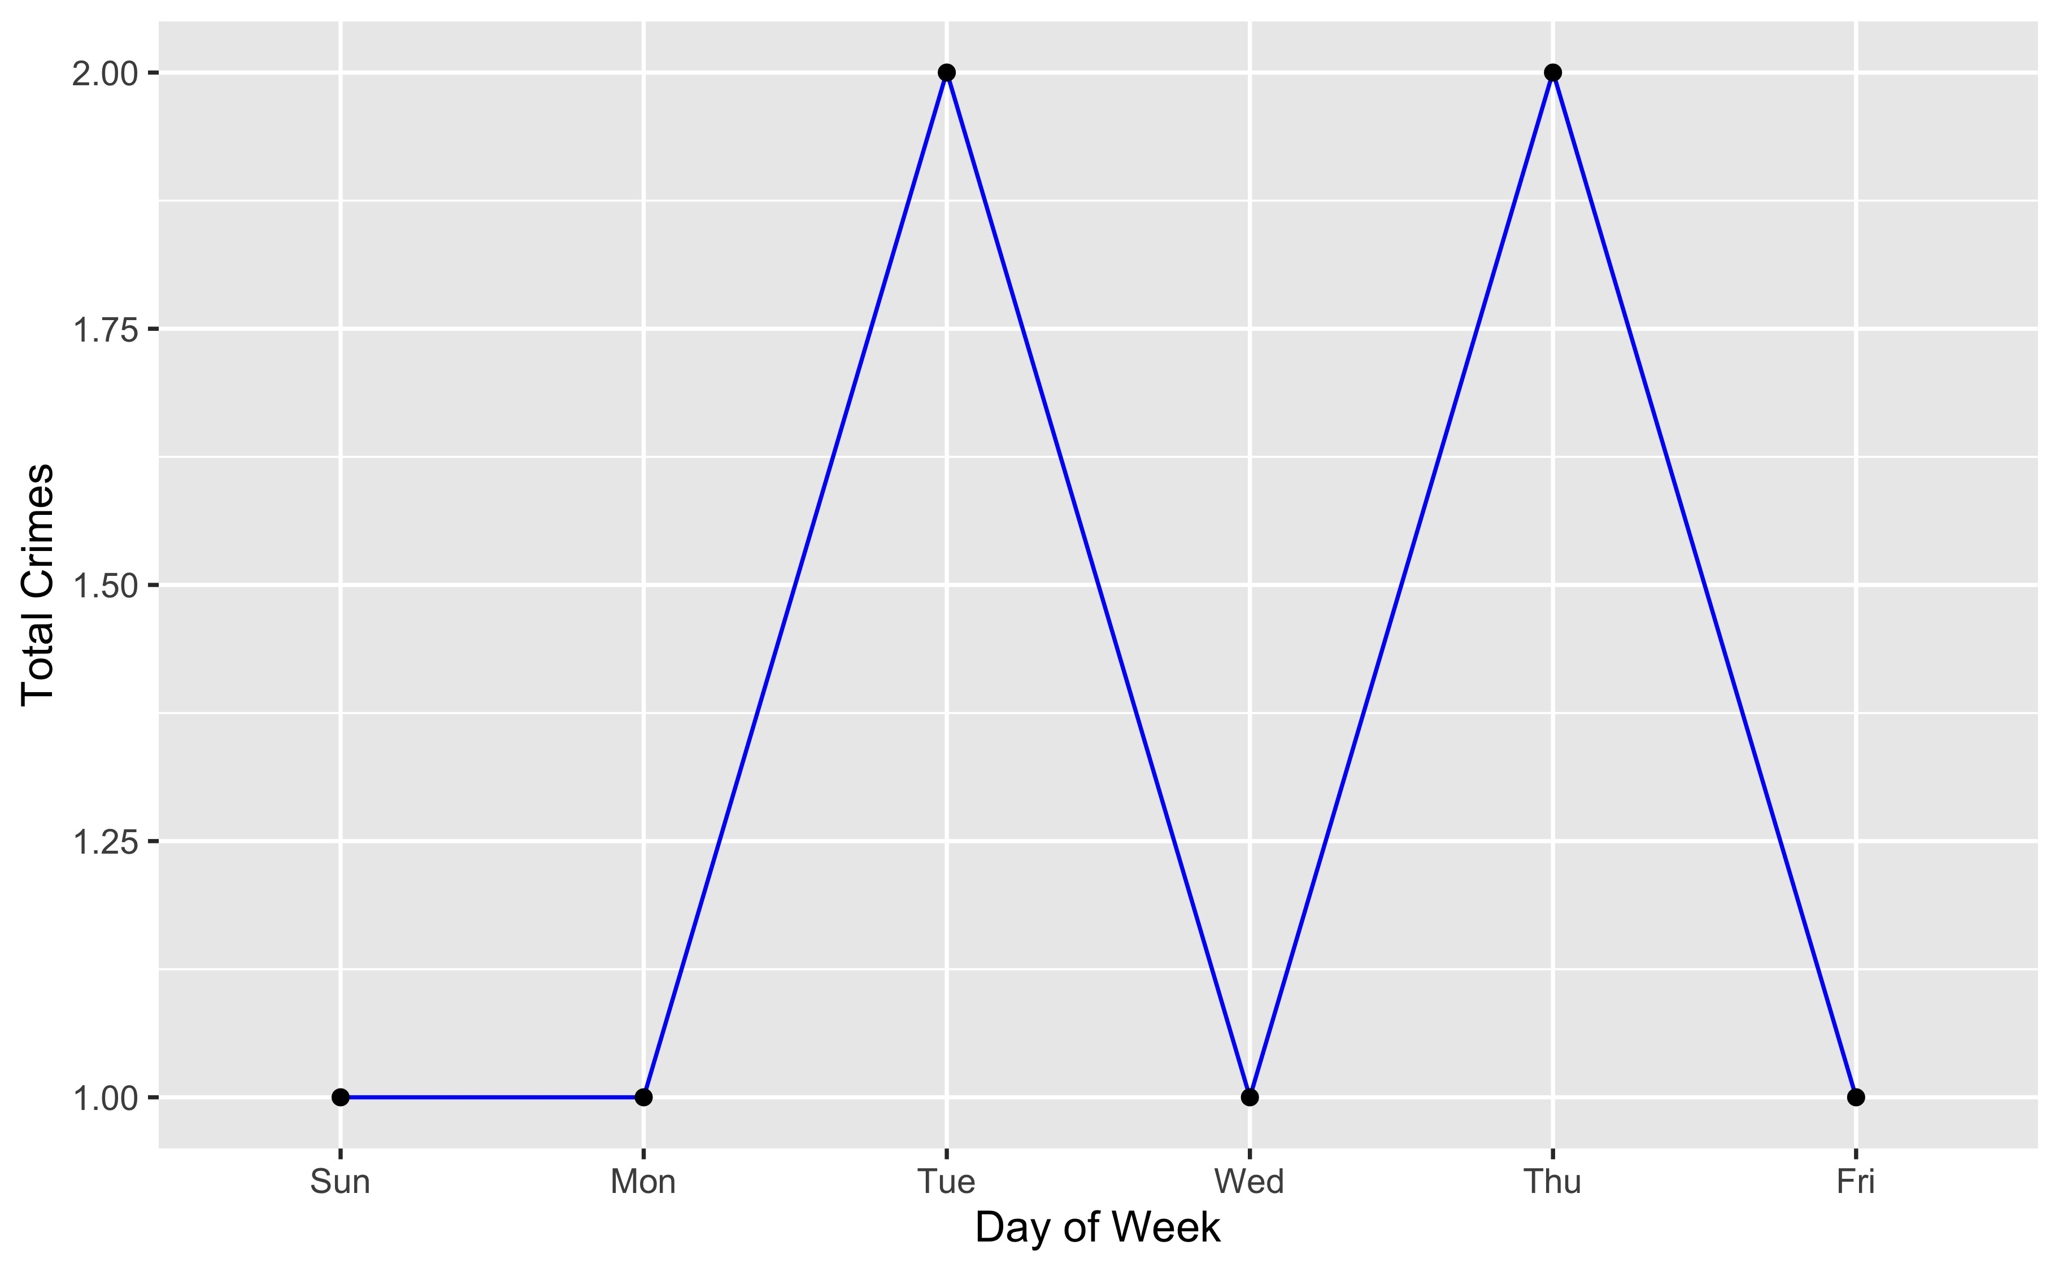
Vandeventer: Total Crimes by Days of the Week

Slide 50
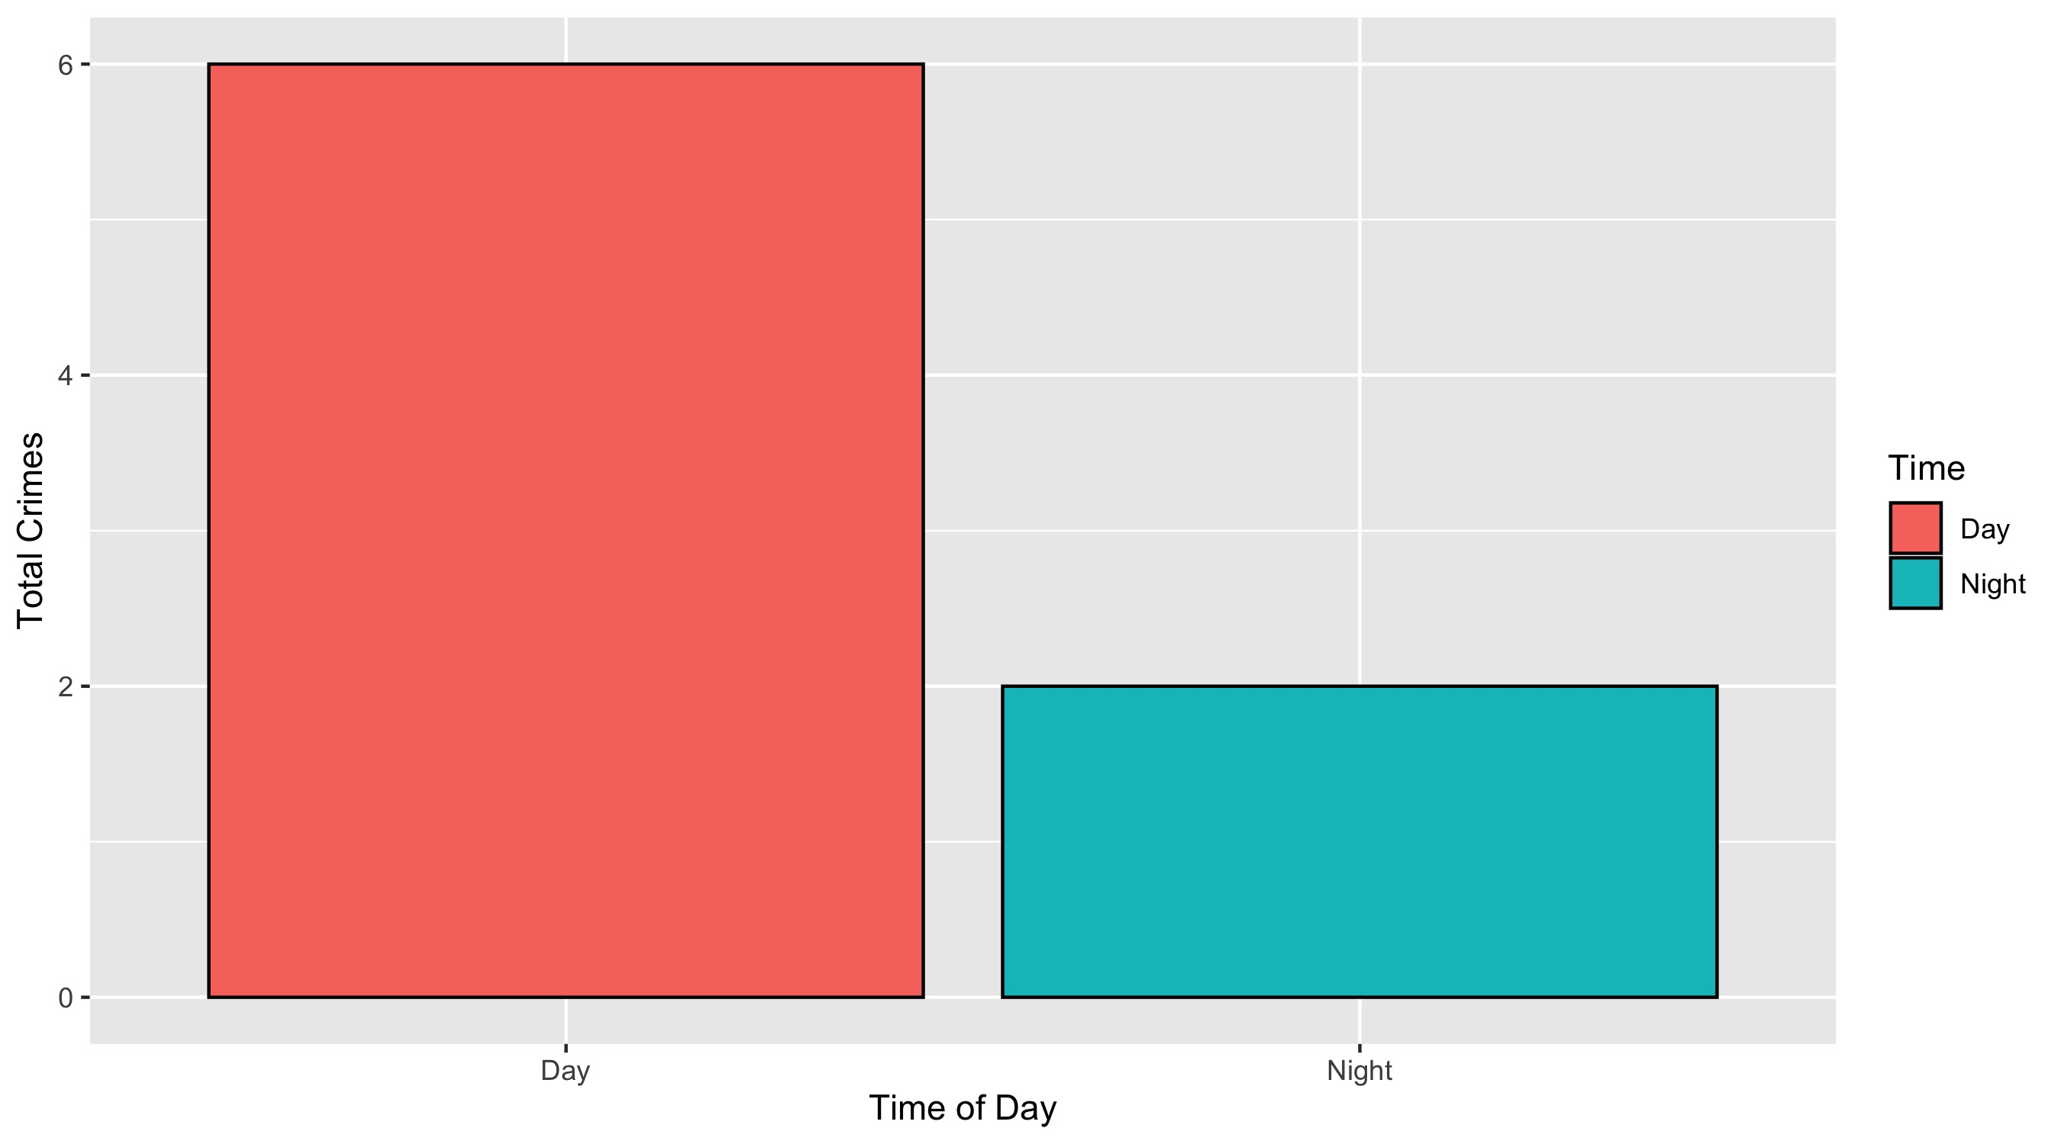
Vandeventer: Crimes by Time of Day

Slide 51
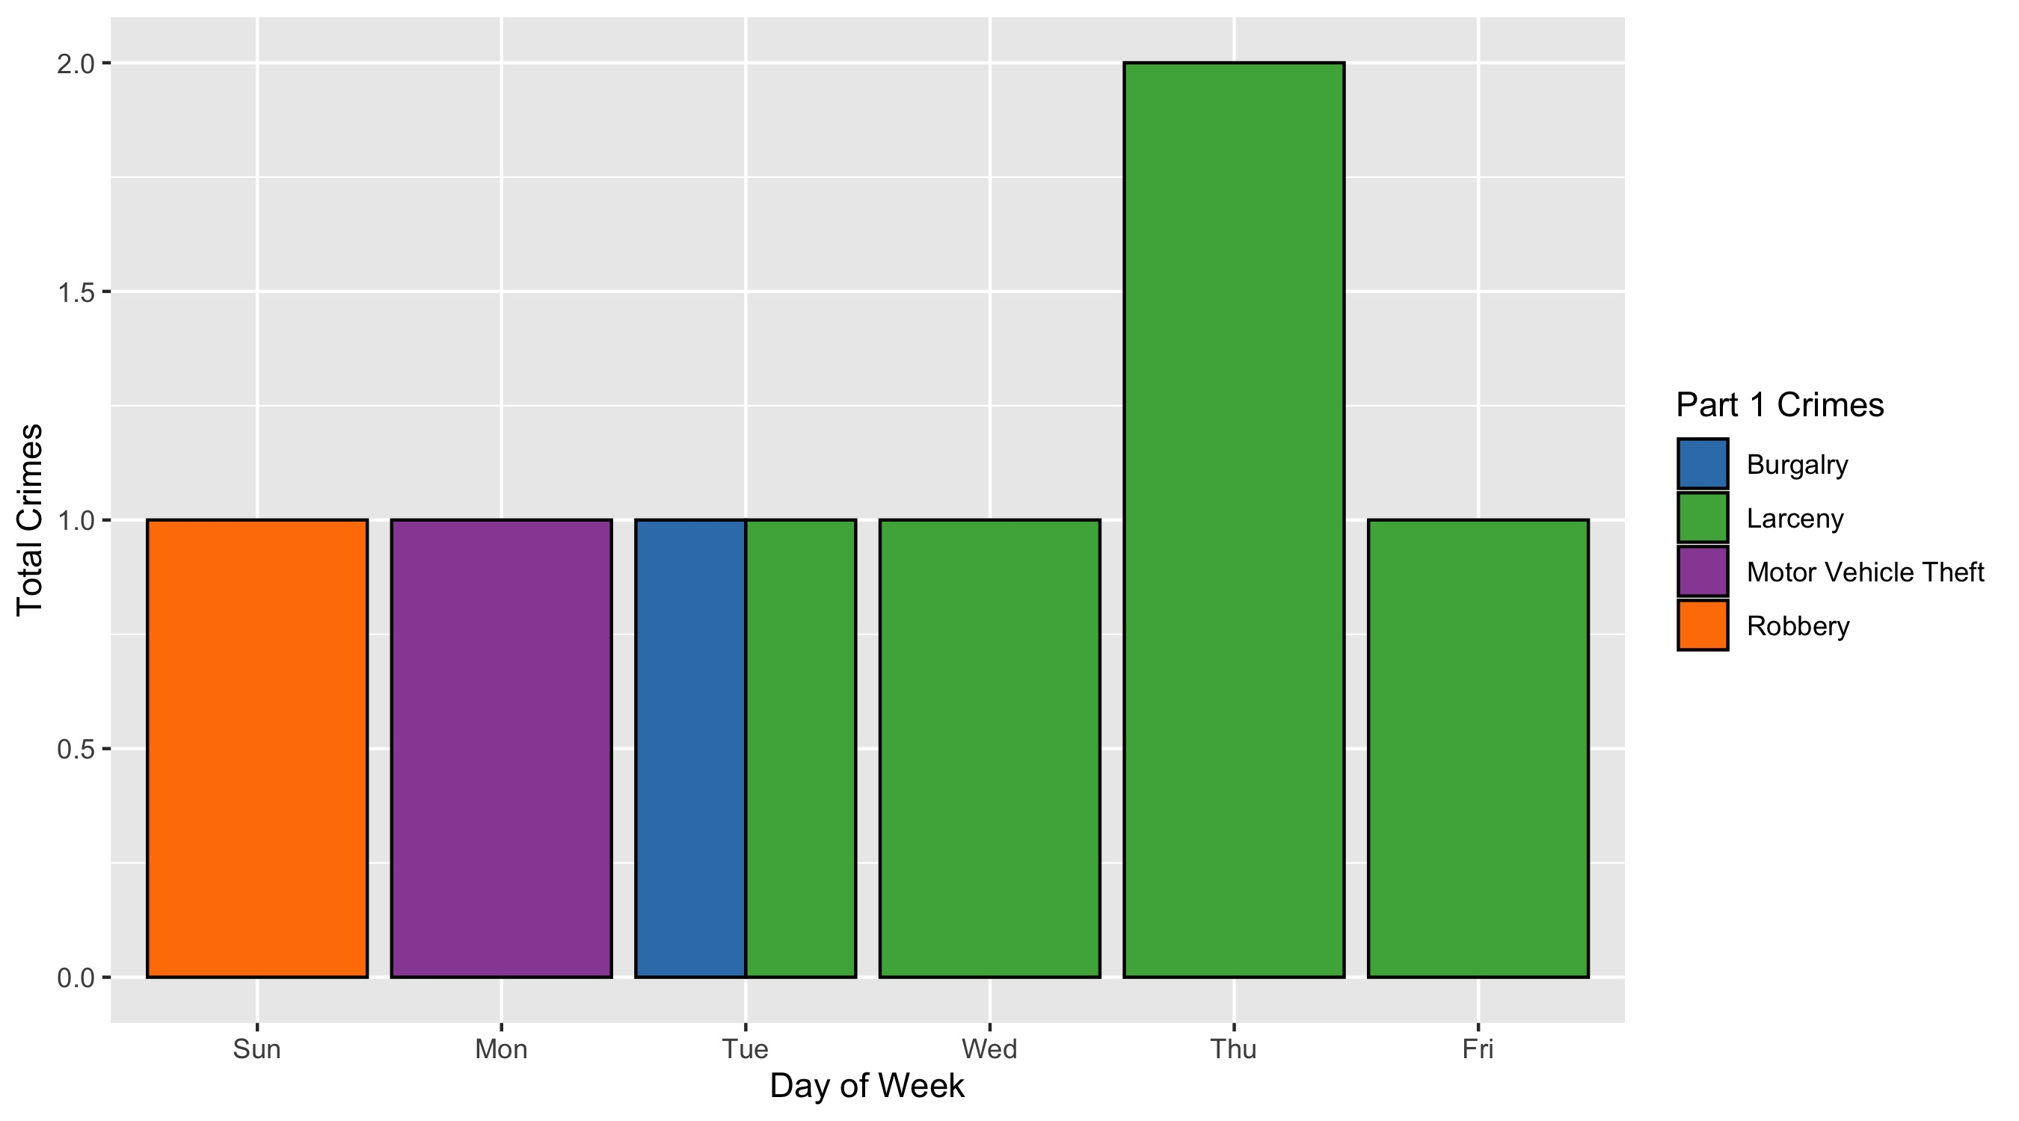
Vandeventer: Crimes by Day and Category

